Slide 1








ESOL & Song-Writing
Relaxation
Conversations
Fluency

Slide 2
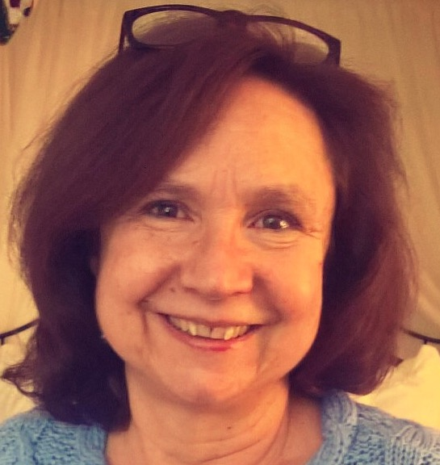
Presenter
Sara Jorgensen,
sjorgensen@rosiesplace.org
Director of Women’s Education Ctr.
at Rosie’s Place, Boston, MA
Sara Jorgensen, Director of Women’s Education Center at Rosie’s Place, has a Master’s Degree in Adult Education and is certified in the State Of Massachusetts as an adult education teacher. She has taught in the classroom for many years at a variety of community-based settings in New York City and Boston and is a co-founder of a non-profit organization. Sara brings more than thirty years of experience in adult education to her current job overseeing as many as 150 teachers and tutors and more than 300 students each year at Rosie’s Place. Rosie’s Place is a community center for poor and homeless women, founded in 1974. It provides a range of services including meals, advocacy and shelter to more than 12,000 women each year. Some of the projects she is most proud of include the development of an ESOL for Human Services Jobs Training Program, A Career Café, The Writing Café, and she is always excited about collaborations with agencies to help connect arts, enrichment, higher education or job training to the Women’s Education Center and to all underserved people who are looking for an opportunity to go back to school, get a job or to try something new.
Notes:
Each person introduces self and role.

Slide 3
Goal of the Workshop
The goal is to learn about ESOL and Song Writing at Rosie’s Place and try it here today.
What else would you like to learn today?

Slide 4
Agenda – ESOL & Song-Writing
1. Rosie’s Place & The Women’s Education Ctr.
2. First song: Everyone Has a Goal
3. Model, method and theory
4. Second song: Don’t Be Afraid
5. Outcomes, benefits and highlights
6. Third song: Came to America
7. Application and reflection
8. Q & A
Notes:
Rahel

Slide 5
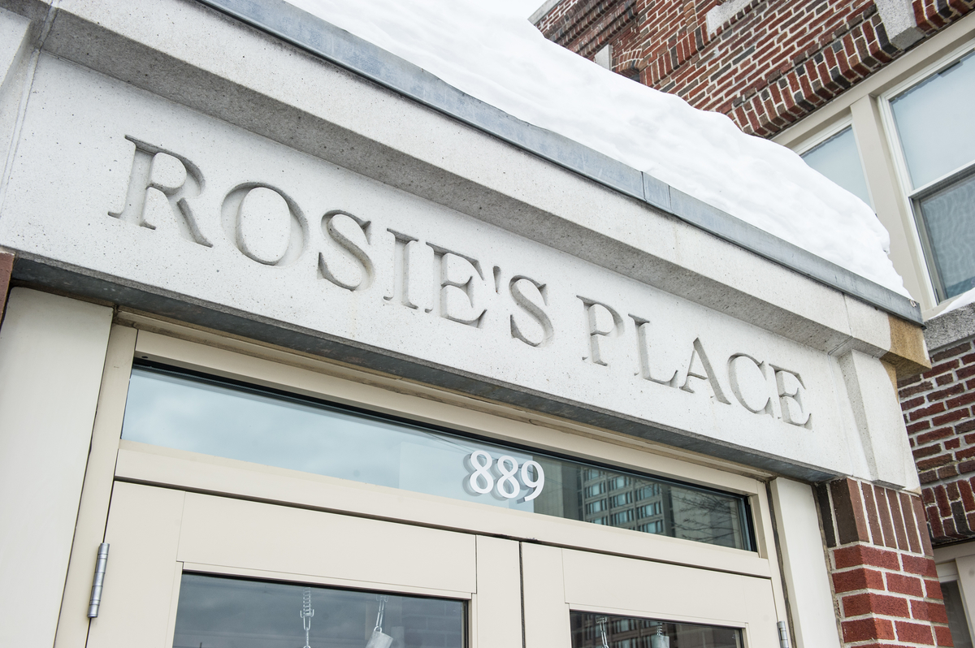
Notes:
Francisca

Slide 6
Our Mission
The mission of Rosie’s Place is to provide a safe and nurturing environment for poor and homeless women to maintain their dignity, seek opportunity and find security in their lives.
Notes:
Francisca

Slide 7
Womens’ Education Center Mission:
The Women’s Education Center,
through educational classes,
workforce development and creative
arts, welcomes women unconditionally
to participate in a compassionate and
celebratory community.

Slide 8
Rosie’s Place at A Glance:
Emergency Services - free meals 365 days a year; food pantry ; showers, laundry and lockers; overnight beds; and health and wellness care.
Opportunity - at our education center including assistance with job and housing searches.
Advocacy and Empowerment - Advocates assist women with short- and long-term issues; attorneys help with legal services; and guests are encouraged to participate and public policy activities.
Outreach - We provide ongoing follow-up to newly-housed guests and home visits to isolated women. We reach women through a satellite office at Franklin Field and collaborations with Boston Public Schools, local shelters, Suffolk County Correctional at South Bay and Massachusetts Trial Courts.
We receive no public funding.
Notes:
Alex

Slide 9
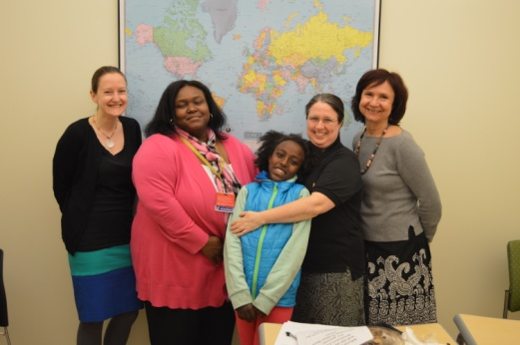
Women’s Education Center, per year:
Serve 300+ ESOL & literacy students
150+ volunteer teachers & substitutes
Year-round day & evening classes, computer lab, tutoring, career & job services
Writing & student publication
Arts and community partnerships
Advocacy - “Know Your Rights” curriculum & visiting the State House
Responsive curriculum designed by staff to meet needs and interests of adult learners
Classes situated in communities of need
Notes:
Sara
Create our own assessment tools and curriculum: Benchmarks for each lower level and goals to accomplish for Level II and Up

Slide 10
About Our “Guests” or Students
Mostly from Haiti, Dominican Republic, China, Somalia, & Cape Verde
Many have experienced homelessness, trauma, abuse or food insecurity
25% did not learn to read or write in their first language or never attended school as children
Many work, raise families, are care-givers and/or went to college in their first language
Most, take advantage of services provided at Rosie’s Place
Notes:
Sara

Slide 11
The Goal Song
Everyone has a goal. My goal is to go to school.
My goal is to go to others, to talk, to write, to
share. Everyone has a goal. My goal is about my
children. My goal is to change my work position.
Makes you a better life.
Everyone has a goal. Help friends and family. When I go
out of the door, I speak with everyone. (2X)
Everyone has a goal. (3X)
Makes you a better life. (3X)

Slide 12
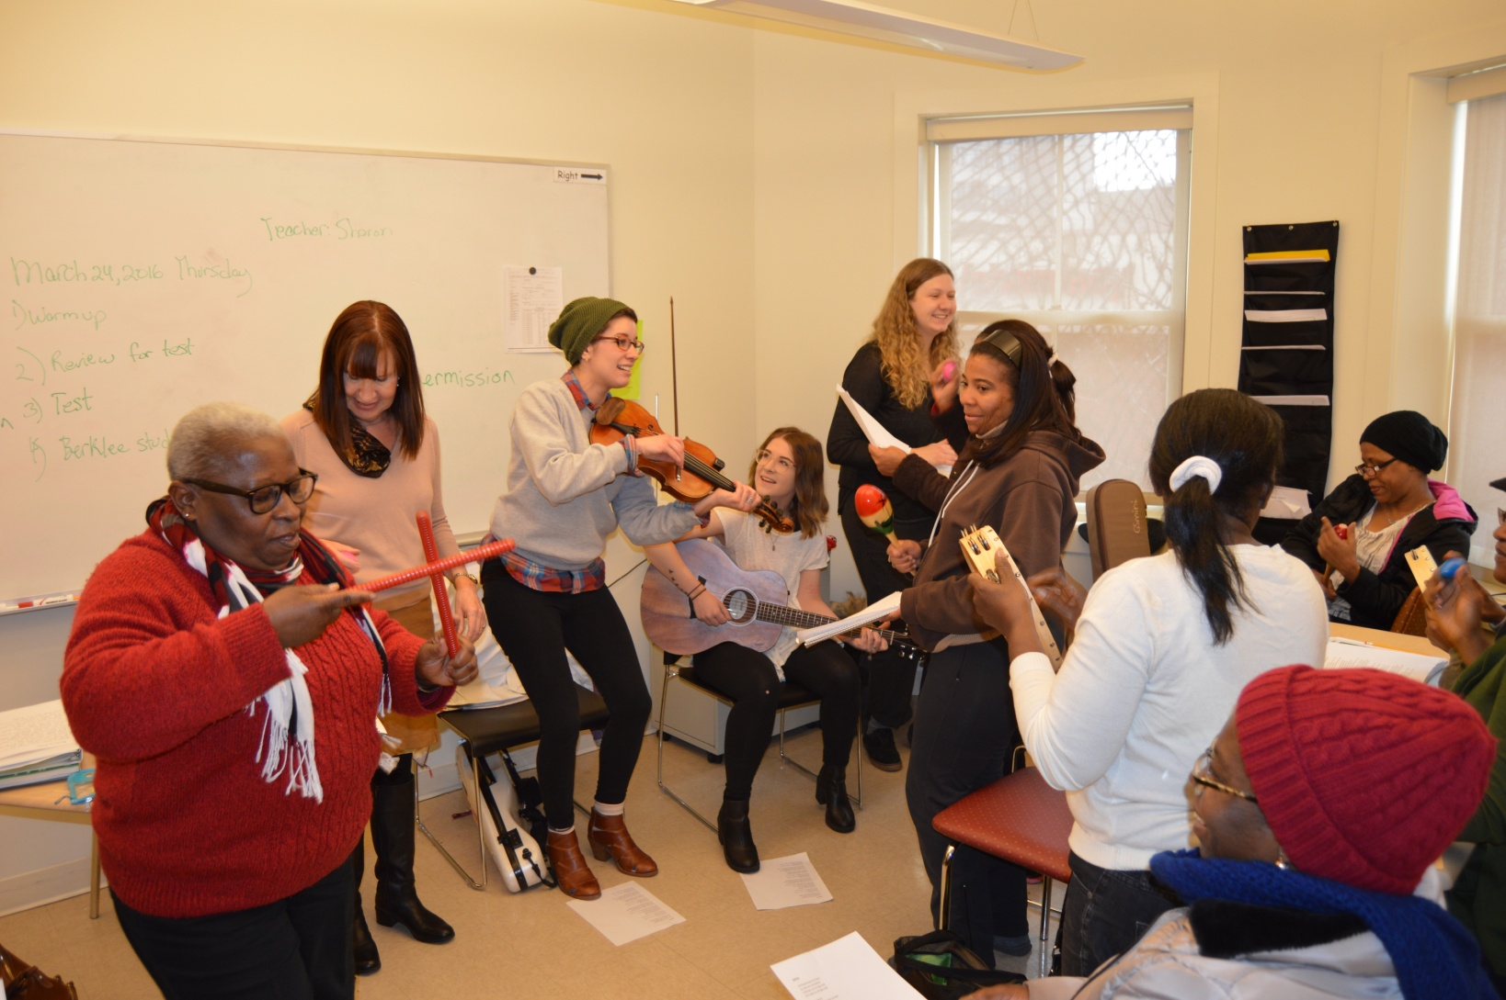
The Song-Writing Class in Action
Notes:
Alex

Slide 13
Our Model
Berklee Students & TA, work with 2 Classes, twice per year.
They meet for one hour per week for 10 weeks.
They create songs in English and perform them at school.
Every class gets a chance to experience the program.
We have a comfortable environment; students are encouraged to take risks.
Berklee brings cultural sensitivity, awareness of trauma and musicality that puts adult education students at ease.
This process is coordinated by Rosie’s Place Women’s Education Center staff.
Notes:
Alex

Slide 14
How does it work?
1. Berklee students are assigned to a class.
2. They attend a required orientation to learn our method of song-writing for ESOL.
3. They observe the class they will work with.
4. They observe and participate while a staff person leads the class using our method.
5. They dive in and engage students in our song-writing method on a weekly basis.
Notes:
Alex

Slide 15
Our ESOL Song-Writing Method
Students converse on topics of interest or school curriculum themes, in small groups. Question lists are provided.
Create text on the board with student responses.
Take a photo of board.
Berklee students meet to create a song.
They teach the song, using echo/choral reading and singing.
Repeat the process and perform favorite songs.
Notes:
Alex – Rahel #4

Slide 16
Language Acquisition Theory
Acquiring language vs. formal instruction
Natural and meaningful interaction are key
Limit self-correction to balance fluency with accuracy
A screen of emotion can block LA or learning (anxiety, self-confidence, motivation or stress).
Based on Stephen Krashen’s Theory of Language Acquisition https://www.youtube.com/watch?v=NiTsduRreug
Notes:
Sara
1. Natural, subconscious process that does not involve formal instruction

Slide 17
DON’T BE AFRAID
1. Somalia, Nigeria, Dominican Republic
2. El Salvador, Puerto Rico, Haiti and China

3. I used to dance, more than anyone.
4. Do you dance? Do you dance?

5. I’m not getting old, I’m getting younger.
6. Don’t be afraid to try. Don’t be afraid to try.

7. 1, 2, 3, 4, don’t be afraid to try.

Slide 18
Student Outcomes:
improved class participation
confidence
fluency
writing & reading
community-building
the songs created are the tangible outcomes
Notes:
Sara and Francisca
Participation and Confidence:Tapping into learning styles: Musical ability, kinesthetic, verbal, writing and visual
Fluency: Repeated reading, echo reading and collaborative oral reading strategies are used. Music and rhythm help with rate and prosody.

Slide 19
The Benefits of Music Therapy
Music releases dopamine, that can increase feelings of pleasure or boost motivation, naturally.
It helps in retrieving vocabulary and fluency with the rhythm of language.
It is a gentle, indirect way to help people with some difficult issues, or trauma.
In small groups, respond to the benefits of music therapy mentioned above.
Notes:
Rahel

Slide 20
What we’ve learned & Highlights
Student perspective:
It helps in learning more English.
Writing songs is very interesting and fun.
Music brings harmony and balance.
Staff perspective:
The order of the class is helpful.
It offers simplicity and clarity of roles.
We have a mutually beneficial partnership.
Teachers gain new perspective on learning.
Notes:
Francisca and Alex

Slide 21
You Are My Sunshine
Make sure everyone knows this tune.
Use the tune of this song to create your group song. Write 1 or 2 verses.
You are my sunshine, my only sunshine.
You make me happy when skies are gray.
You never know dear how much I love you.
Please don’t take my sunshine away.

Slide 22
create a short song with a familiar tune
                1. Break into groups of 5 or so.
                2. Choose a topic: goals, work, childhood, holidays, immigration or a topic of interest to your group.
                3. Converse in your small groups. Use the topical questions provided. Write down the ideas people share.
                4. Create a group text with your ideas.
                5. Try to adjust your text to fit into the structure of the song, “You Are My Sunshine,” and sing!!
                6. Share your song with the group!
                * Feel free to skip #4.
Notes:
Alex and Rahel

Slide 23
Reflection
                How could this model be adjusted for your program?
                What ideas do you have that can address the emotional needs of your students?
Notes:
Do this while Rahel is preparing a song.
Sara

Slide 24
Some Contacts/Resources
Sara Jorgensen, (617) 318-0215, sjorgensen@rosiesplace.org , Director of Women’s Education Ctr. at Rosie’s Place, Boston, MA
Cadence Podcast- Free Listening on SoundCloud. “Writing Songs to Learn English” - Podcast about The Rosie’s Place-Berklee program. Sign in to Cadence Podcast Through SoundCloud. Choose Episode 3 writing-songs-to-learn-english.
Lyriko, Learn Languages with Music, http://www.lyriko.com/en/ Masako, Producer (Boston, USA)
Skylight Games' first app, Lyriko: Learn Languages with Music, makes learning fun,
effective, convenient, and social, empowering independent learners everywhere to reach
these goals. Free app.

Slide 25
I came to America
I came to America.
I came by a plane.
I came by swimming.
I brought baby things.
I brought a suitcase with clothes and tea, some books and a dictionary.
My family, long time no see. I feel excited, surprised happy. 2X

Slide 26
Let It Be – Use this as a model to write your own song.
Written and Performed By The Beatles
Verse 1
When I find myself in times of trouble
Mother Mary Comes to me
Speaking words of wisdom
Let it be
Verse 2
And in my hour of darkness
She is standing right in front of me
Speaking words of wisdom
Let it be
Chorus:
Let it be. Let it be. Let it be. Let it be.
Speaking words of wisdom. Let it be….

Slide 27
Lean on Me
Use this as a model to write your own song.
Sometimes in our lives we all have pain
We all have sorrow
But if we are wise
We know that there's always tomorrow
Lean on me, when you're not strong
And I'll be your friend
I'll help you carry on
For it won't be long
'Til I'm gonna need
Somebody to lean on
Please swallow your pride
If I have things you need to borrow
For no one can fill those of your needs
That you won't let show
You just call on me brother, when you need a hand
We all need somebody to lean on
I just might have a problem that you'll understand
We all need somebody to lean on
Lean on me, when you're not strong
And I'll be your friend
I'll help you carry on
For it won't be long
'Til I'm gonna need
Somebody to lean on
You just call on me brother, when you need a hand
We all need somebody to lean on

