Slide 1
Fostering Independence: Helping Students Become more effective self-directed learners
Sarah Lynn First Literacy 2017

Slide 2
A Chinese Proverb
Teachers open the door.
You enter by yourself.
a. What does this mean?
b. Do you have an example from your own life as a
teacher or a student?

Slide 3
Today’s Workshop
Participants will learn classroom activities and routines to develop ​students’​essential “learning-to-learn” skills.
Participants will explore ways to get lower level students to recognize themselves as agents in their ​own ​learning and develop the methods, skills, and practices they need to ​become more independent learners.

Slide 4
Framing the Conversation
What are “essential learning-to-learn skills”?
  Write a list
  Debrief
How do students learn these skills?
  Write three ideas.
  Talk with a partner.

Slide 5
Persistent students believe:
I belong here.
This work has value for me.
My ability & competence grow with my effort.
I can succeed at this.
Farrington, Teaching Adolescent to Become Learners

Slide 6
“To become self-directed learners, students must learn to monitor and adjust their approaches to learning. “
Ambrose in How Learning Works

Slide 7
Three Guiding Principles
Learning begins with the learner.
The student must recognize him or herself as a learner.
Learning skills and strategies are learned with schooling.

Slide 8

https://www.iconfinder.com/icons/696541/google_gps_location_map_mapquest_maps_pin_icon

Slide 9
Learning begins with the learner.

Slide 10
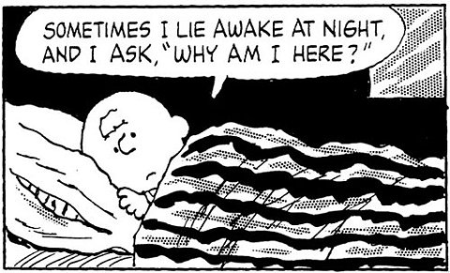
Why am I here?
https://jeffblock.files.wordpress.com/2016/02/charlie-brown-why-am-i-here.jpg
Take a minute to respond.

Slide 11
What are your students’ goals?

Slide 12
Think-Pair-Share
How do you find out your students’ goals?
How do you develop students’ goal-setting skills in your class?

Slide 13
Goal Setting Skills
You got to be careful if you don’t know where you’re going, because you might not get there.
~Yogi Berra

Slide 14
Goal-Setting Activities
1. Pictures & Contract
2. Unit by Unit
3. Class by Class

Slide 15
Pictures and a Contract
Name photos.
Place photos and titles around the room.
Students stand by their chosen photo.
Students write their goals in a contract.

Slide 16
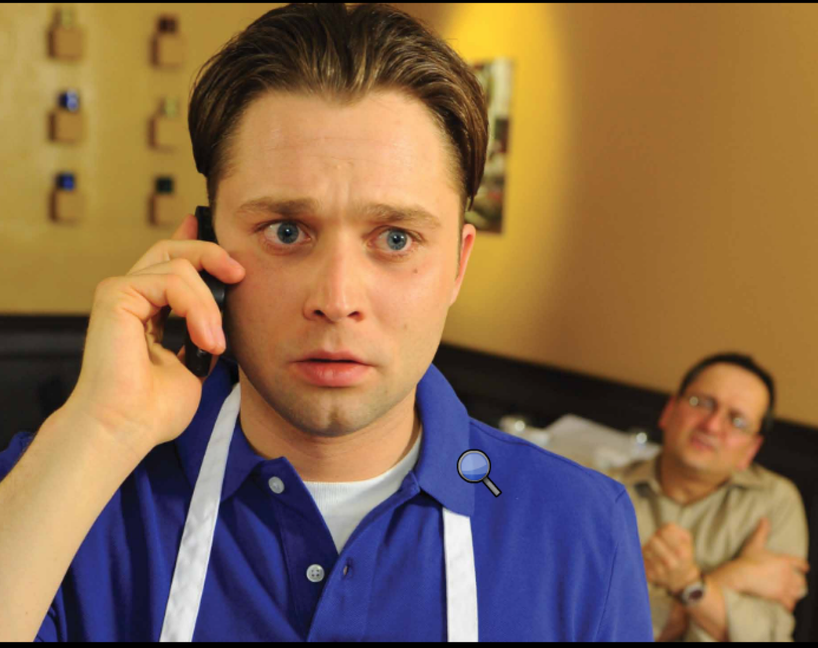
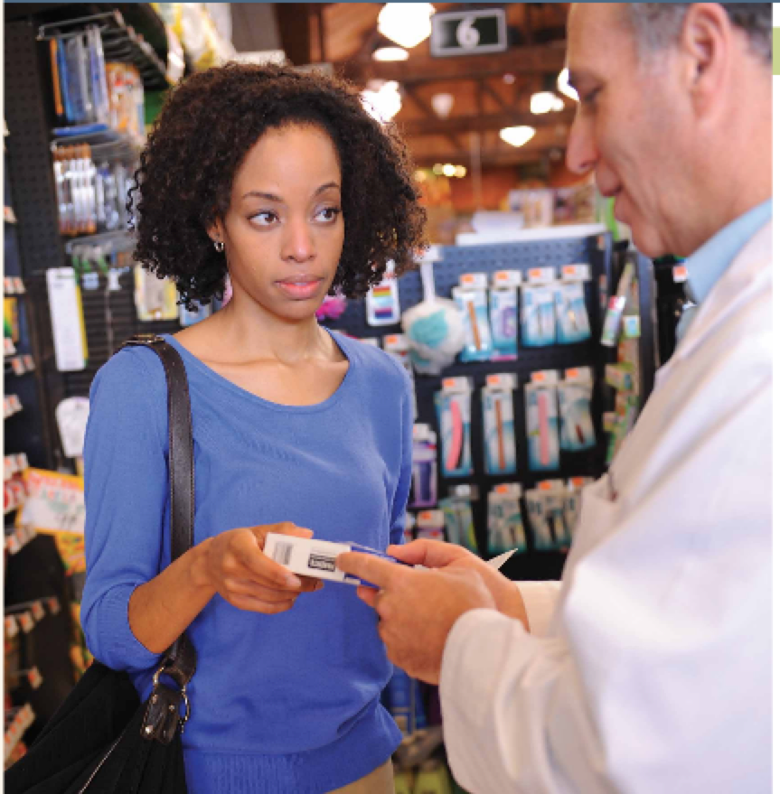
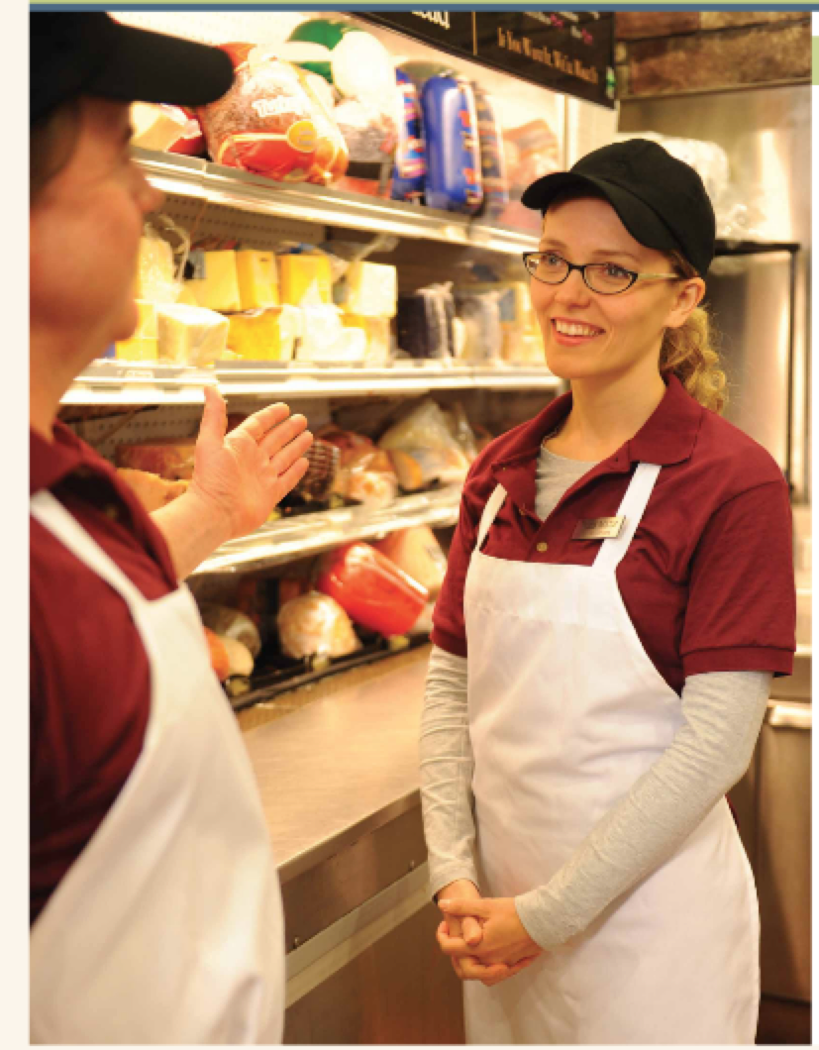
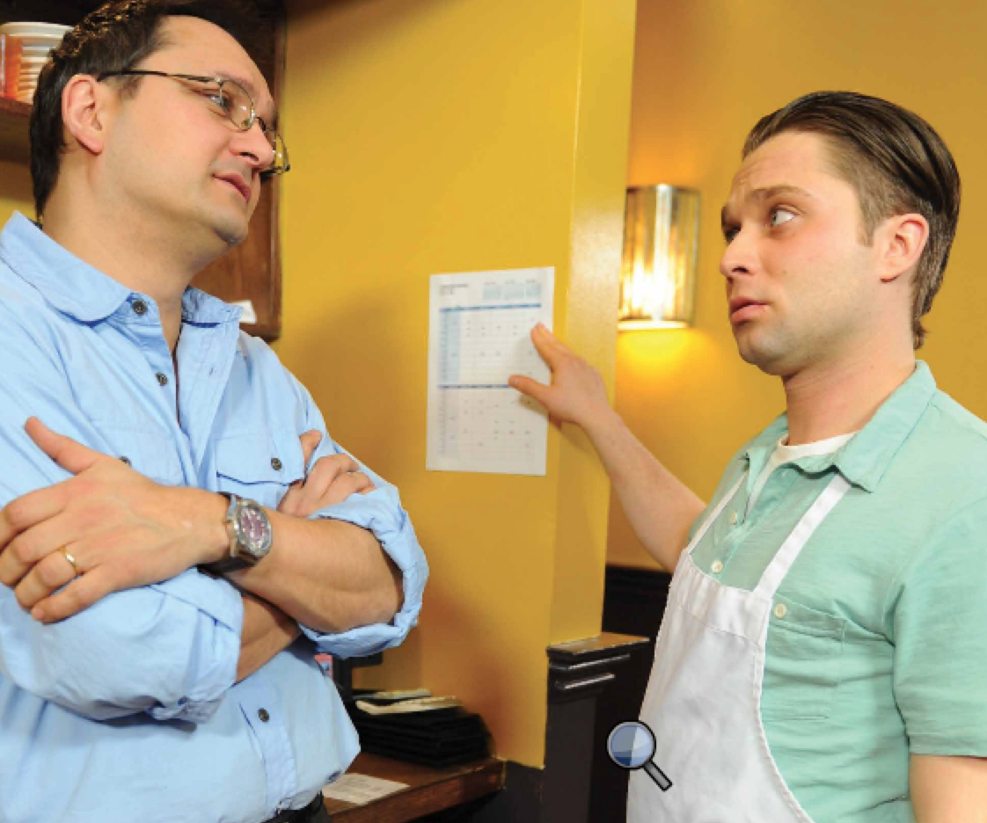
Pictures

Slide 17
A Contract
I want to learn English so I can ____________________. I want to learn English so I can _______________. I want to learn English so I can _______________.
Student Signature _______________________________ Date: _ _ / _ _ / _ _
Teacher Signature _______________________________ Date: _ _ / _ _ / _ _

Slide 18
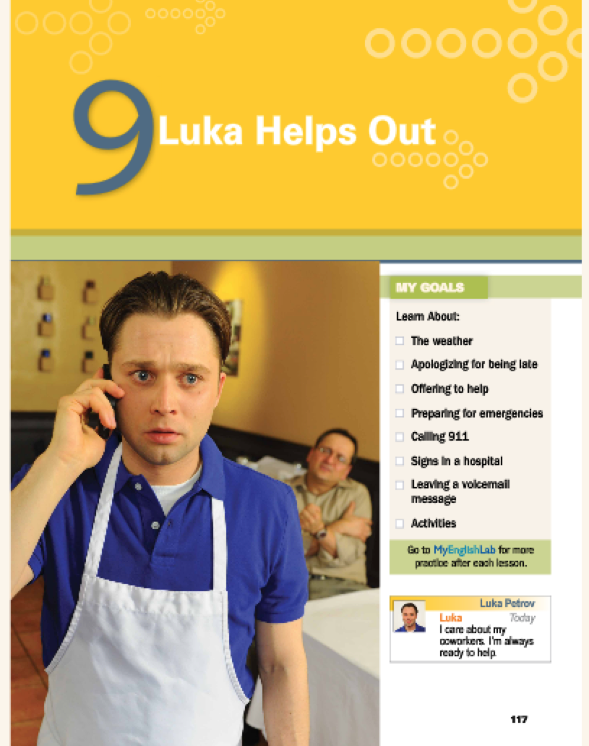
Identify Goals: Unit by Unit
Identify the unit goals.
Ask: What’s most important to you in this unit? Why?
Have students tell the class their #1 goal for the new unit.

Slide 19
Identify Goals: Class by Class
Write objectives for each class.
Write an agenda for the class.
Review the agenda with the class in order to plan next class.

Slide 20
Think-Pair-Share
Choose one of the 3 goal-setting activities :
How would you use it in your class?

Slide 21
  Connect Classroom Learning to Life
A STUDY by Christopher Hulleman at the University of Maryland
After each class . . .
Group A wrote a summary of the day’s learning.
Group B identified how the day’s learning related to their lives.
  Which group showed more robust learning?

Slide 22
Activities to Connect Classroom Learning to Life
Think about your curriculum choices.
Engage students in making connections.

Slide 23
Think about your Curriculum Choices
Why is this material important to my students?
How will my students use this knowledge outside of class?

Slide 24
Get Students to Make the Connections
Why are we doing this?
When and where will you use this outside of class?

Slide 25
A StudY
In 2007 Garfield, Del Mas, & Chance compared student mastery of the concept of variability in a college statistics course.
Group A: A traditionally taught course.
Group B: Students were asked to generate examples in their own lives of activities that had either high or low variability, to represent them graphically, and draw on them as they reasoned about various aspects of variability.
Group B outperformed students in the baseline class two to one.

Slide 26
Ask for examples from students
Give an example
from your life.

Slide 27
Recap
What activities have we talked about so far?

Slide 28
Break

Slide 29
Students must recognize themselves as learners.

Slide 30
Pair Reading
1. In pairs self assign one of these roles:
Partner A: Evaluating Strengths and Weakness
Partner B: Monitoring Performance
Each partner reads the passage and marks an exclamation point next to any interesting point.
Tell your partner one interesting point. Explain why you found it interesting.

Slide 31
Overcoming the biases
Students need time and space to develop mastery.
“To develop mastery, students must acquire component skills, practice integrating them, and know when to apply what they have learned.”
Ambrose, How Learning Works

Slide 32
Where am I?
https://www.iconfinder.com/icons/696541/google_gps_location_map_mapquest_maps_pin_icon

Slide 33
Where am I?
Self-assessment
Self-reflection
Self-advocacy

Slide 34
Self-Assessment
True wisdom is knowing
what you don’t know.
~ Confucius

Slide 35
Self-Assessment Activities
1. Total Recall
2. Explain Your Thinking
3. Retell with Key Words
4. Stand & Talk

Slide 36
Group A studied the material and reviewed notes.
Group B was asked to recall their learning without notes or prompts.
Two days later: Which group performed better?
A week after that:
  Which group remembered 48% of the material?
  Which group remembered 90%?

Slide 37
Reviewing vs. Recalling
When you review material, you are recognizing material that looks familiar.
When you recall material, you are remembering it.
Recall is more effective than review.

Slide 38
TOTAL RECALL

Slide 39
Explain Your Thinking
What is the answer? How do you know?
Please explain it to your partner.

Slide 40
Explain Your Thinking
Just expecting to teach material to another student improves a student’s grasp of material.
improves recall, particularly of main points
improves organization of material
~ Nestojko ,Bui, Kornell & Bjork, 2014

Slide 41
Retell with Key Words
After learning a new point, have students explain their learning to one another.
1. Individually students identify three key words.
2. Students turn and talk with a partner to share their key words and explain why they selected them.

Slide 42
Stand and Talk
After a learning activity, have students stand up and talk about what they just learned. They can answer any of the following questions:
What did we just learn?
What was most interesting to you?
How will you use this information?
What questions do you have?

Slide 43
Stand and Talk
Explain the steps of each of these classroom activities:
Total Recall
Explain Your Thinking
Retell with Key Words
Stand and Talk

Slide 44
Self-Reflection Activities
Mark the Margins
Class Recap & Reflection
Skill Self-assessment

Slide 45
Mark the Margins
For homework assignment and class notes:
✓ - I understand
? - I don’t understand

Slide 46
Class Recap & Reflection
Today in class we did:
_____________________________________
_____________________________________
_____________________________________
_____________________________________
I liked ________________________________.
I want to practice more____________________.

Slide 47
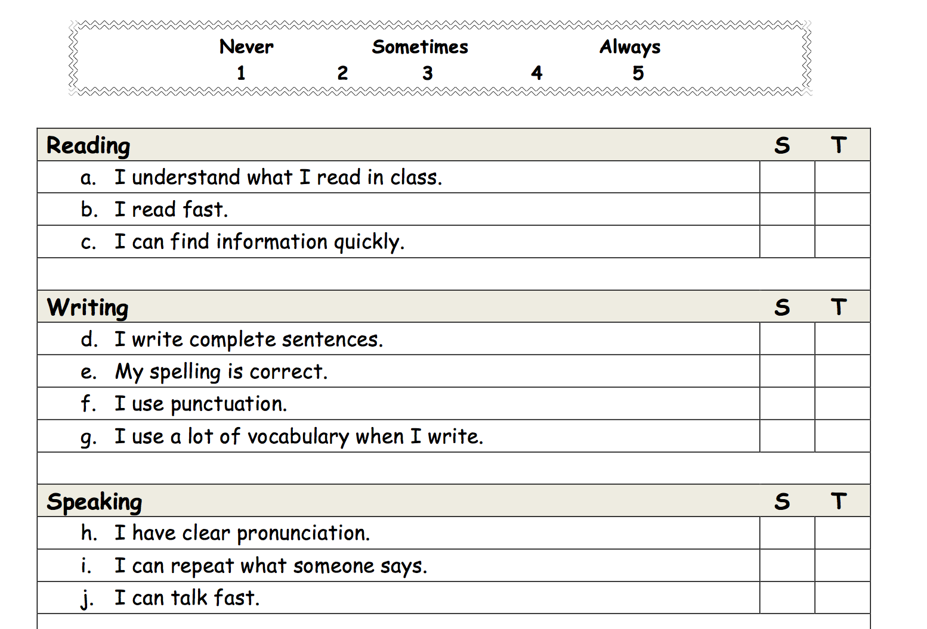
Skill Self-Assessment
Add sample here:

Slide 48
Self-Advocacy Activities
1. Classroom Questions
2. Pause for Focused Questions

Slide 49
Self-Advocacy Skills
Never do for someone
what they can do for themselves.
~ Saul Alinsky’s Iron Rule

Slide 50
Classroom Questions
Provide question models.
Chorally practice the questions.
Assign each student one question per class.

Slide 51
Pause for Focused Questions
Do you have questions about X?

Slide 52
KEY WORD RETELL
“Instructors should take care not to do the thinking for learners or tell them what to do because this runs the risk of making students experts at seeking help rather than experts at thinking about and directing their own learning. “
  TEAL Center Fact Sheet No. 4:
  Metacognitive Processes 2012

Slide 53
CLOSE THE LOOP
Look at your goals you wrote at the beginning of the session.
What did you learn today?

Slide 54
Thank you!
SarahLynn41@gmail.com

