Slide 1
Pushing your HSE Students to the College & Career Ready Threshold
Michael Farma HSE Specialist Mass DESE
First Literacy – Sept 28, 2018

Slide 2
01
What Is New In HSE?
02
Which Test Should My Student Take?
CONTENTS
03
Registration and Admission
04
Taking the Test
05
I Took the Test– Now What?

Slide 3
01
What’s New in HSE ?

Slide 4
What’s New In HSE ?
https://vimeo.com/251570555
http://www.doe.mass.edu/hse/
Spanish Testing – If a student takes one or more sub-tests in Spanish, they will receive their credential in Spanish.
Picture ID – Student ID must exactly match the name on the registration.
Diplomasender.com – New score report /credential.
Extra questions on HiSET – More time on GED Math.

Slide 5

Which Test Should My Student Take?
02

Slide 6
Which Test Should My Student Take? – Why Two Tests?
HiSET
GED
    Continuity of testing.
    No sun setting of scores.
    Continued availability of a paper-based option.
    Traditional-looking test.
    Closer alignment to the CCRSAE.
    Excellent test feedback and preparation options.
    Potential for a college-ready cut score.

Slide 7
Which Test Should My Student Take?
HiSET
GED
Language Arts-Reading (65 minutes) 50 multiple choice questions.
Language Arts-Writing (120 minutes) 61 questions.
  60 multiple-choice questions.
  1 Essay.
Reasoning through Language Arts (150 minutes)
(51 Questions) Section 1 — (27 minutes*).
Section 2 — Extended Response (45 minutes).
Student Break (10 minutes).
Section 3 — (60 minutes).
*The time allotted for Sections 1 and 3 may vary slightly, but the total test time will always be 150 minutes.

Slide 8
Which Test Should My Student Take?
HiSET
GED
Mathematics (90 minutes) 60 Multiple-choice questions.
Calculator: TI-30XS scientific calculator.
Mathematical Reasoning (115 minutes)
(46 Questions) Part 1 (first 5 questions) calculator not allowed.
Part 2 (remaining 41 questions) calculator allowed.
Possible Item Types:
  Multiple choice
  Drag-and-drop
  Hot spot
  Fill in the blank
Calculator: TI-30XS scientific calculator .

Slide 9
Which Test Should My Student Take?
HiSET
GED
Social Studies (70 minutes) 60 Multiple-choice questions.
Social Studies (70 minutes)
(35 questions) Possible item types:
  Multiple-choice
  Drag-and-drop
  Hot spot
  Fill in the blank.
Calculator: TI-30XS scientific calculator.

Slide 10
Which Test Should My Student Take?
HiSET
GED
Science (80 minutes) 50 Multiple-choice questions.
Calculator: TI-30XS scientific calculator.
Science (90 minutes)
(34 Questions) Possible Item Types:
  Multiple-choice
  Short answer
  Drag-and-drop
  Hot spot
  Fill in the blank.
Calculator: TI-30XS scientific calculator.

Slide 11
Which Test Should My Student Take?
HiSET
GED
Scoring:
Scaled-score range per subtest: 0-20.
To pass: no subtest score lower than 8 and a battery total of 45 or above.
Human scored essay.
Scoring:
Scaled-score range per module: 100-200.
To pass: a score on each module of 145 or above.
“Automated” scored short answers and essays.

Slide 12
Which Test Should My Student Take?
What assessment style suits you best.
  If you use the CCRSAE to develop your Scope & Sequences your student will be ready for either.
    “However genuine the concerns about setting the bar higher for college and career readiness, a willingness to act on what educators and employers have clearly identified as nonnegotiable knowledge and skills is essential to enabling adult learners to meet the real-world demands of postsecondary training and employment.” (CCRSAE/CCR Standards Adult Ed)
  Take both practice tests.
  Determine not on which assessment you scored higher but with which did you feel most comfortable ?

Slide 13
03
Registration and Admission

Slide 14
Registration and Admission
    www.hiset.ets.org
    www.GED.Com
    Follow the links for test takers.

Slide 15
Registration and Admission
Massachusetts Requirements :
Age: You must be 18 years or older to be eligible to take the HiSET exam in Massachusetts with no qualifications. If you are 16 or 17, you can take the exam, but you will need a letter of withdrawal from your last school attended.
School Enrollment Status: You must NOT be enrolled in any secondary school program and must not have received a high school diploma or high school equivalency credential.

Slide 16
Registration and Admission
View the requirements for taking the exam in Massachusetts to make sure you're eligible to take the exam.
Set up your My HiSET Account or GED.com account .
Find a test center near you.
Schedule your appointment.
Schedule online through your HiSET/GED account (Massachusetts Requirement).
Call ETS Customer Service at 1-855-MyHiSET (1-855-694-4738). *
or GED Customer Service at 1-877-EXAM-GED (877-392-6433).
* There will be a $10 surcharge for this effective Jan 1, 2019.

Slide 17
Registration and Admission
Residency: You must be a resident of Massachusetts, living at a Massachusetts address. You will be required to sign an eligibility form verifying your address. The eligibility form will be provided to you by the test center on your test day.
Test Preparation or Instruction: Massachusetts does not have any test preparation or instruction requirements to take the HiSET exam. However, instruction is encouraged before retesting.
Practice Test: Massachusetts does not require you to take practice tests prior to taking the HiSET exam.

Slide 18
Registration and Admission
HiSET
GED
Fee Structure:
$100/battery ($24 for the 1st subtest, $19 for the remaining 4 subtests in the initial battery).
$9/retest (up to two per subtests, within one year of initial test).
$19/subtest (after one year from initial test).
Starting January 1, 2019:
$103.75/computer battery.
$125/paper battery.
(with a proportional increase in individual and subtest fees).
Fee Structure:
$125/battery ($31.25/module).
$10/retest (up to two per module, within one year of initial test).
$31.25/retest (after one year from initial test).

Slide 19
Registration and Admission
Identification: You must present proper identification at the test center for each test session. Identification must exactly match the name on the registration. Outdated or expired identification will not be accepted. Failure to provide documentation will prohibit you from taking the exam. The approved identification documents include:
  A valid passport;
  A valid driver's license from any state;
  A state-issued ID card;
  National ID card;
  Military ID card.

Slide 20
Registration and Admission
HiSET
GED
Sign In
  Candidate will be asked to sign in manually.
Sign In
  Candidate will be asked to sign in on e-pad.
  Candidate will have picture taken.

Slide 21
Registration and Admission
HiSET
GED
Candidate will be shown where to store belongings – including cell phone.
Candidate will be given up to three pieces of scrap paper and a pencil.
Candidate will be given TI 30-SX Calculator for Math and Science.
Computer will assign work station (except for special accommodation).
Candidate will be shown where to store belongings – including cell phone.
Candidate will be given three erasable note sheets and an erasable pencil.
Candidate will demonstrate that there is nothing in his/her pockets.
Candidate will be given TI 30-SX Calculator for Math*, Science. Social Studies (*Math after 1st five questions.)
Test administrator will assign work station.

Slide 22
04
Test Material

Slide 23
Test Material
In a study completed by WestEd, September 30, 2015, it was stated that “overall the study indicated high rates of total alignment (strong and partial combined) between the 2016 ETS HiSET Exam in ELA and mathematics (87% and 88% respectively) and the CCRSAE”. (https://hiset.ets.org/s/pdf/2015-wested-study.pdf)
https://www.gedtestingservice.com/uploads/files/652b969a13a0126c909facc5aa166363.pdf
https://hiset.ets.org/s/pdf/2019_taag.pdf

Slide 24
Test Material
GED RLA - Reading
  Seventy-five percent of the texts in the exam are informational texts (including nonfiction drawn from the science and the social studies as well as a range of texts from workplace contexts); 25 percent are literature.
  The texts included in the test cover a range of text complexity, including texts at the career and college readiness level.
  For texts in which comprehension hinges on vocabulary, the focus is on understanding words that appear frequently in texts from a wide variety of disciplines and, by their definition, are not unique to a particular discipline.
  U.S. founding documents and the “the Great American Conversation” that followed are required texts for study and assessment.
  The length of the texts included in the reading comprehension component of the test vary between 450 and 900 words.

Slide 25
Test Material
GED RLA – Writing
  Draw relevant and sufficient evidence from a literary or information text to support analysis and reflection.
  Use technology to produce writing, demonstrating sufficient command of keyboarding skills.
  Candidate responses are scored by a multi-trait rubric that focuses on three elements:
    Trait 1: Analysis of arguments (plural) and use of evidence.
    Trait 2: Development of ideas and structure.
    Trait 3: Clarity and command of standard English.

Slide 26
Test Material
HiSET Writing
  Organization of Ideas (22%).
  Language Facility (43%).
  Writing Conventions (35%).
  The multiple-choice questions require candidates to make revision choices concerning organization, diction, and clarity, sentence structure, usage, and mechanics.
  The essay question measures proficiency in the generation and organization of ideas through a direct assessment of evidence-based writing. Candidates read a pair of texts and then create written responses. Responses are evaluated on the candidates’ abilities to develop positions or claims supported by evidence from the materials provided as well as their own experiences.

Slide 27
Test Material
HiSET Reading
  Application of concepts, analysis, synthesis, and evaluation involving:
    Literary Texts (60%)
    Informational Texts (40%) .
  In the ETS HiSET program, candidates will be required to read a broad range of high-quality literary and informational texts. The selections are presented in multiple genres on subject matter that varies in purpose and style. The selections will span various forms (e.g., narratives, memoirs, essays, biographical sketches, editorials, and poetry). The texts generally range in length from approximately 400 to 600 words.

Slide 28
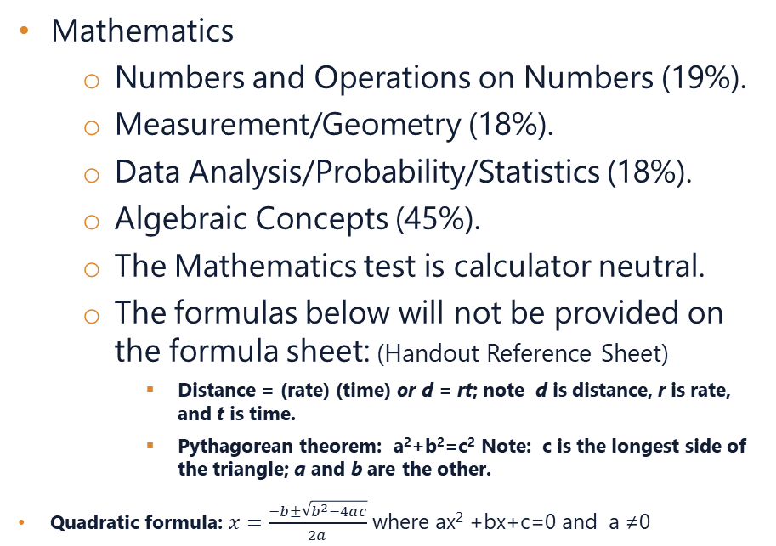
Test Material
HiSET
GED
Mathematics
  Numbers and Operations on Numbers (19%).
  Measurement/Geometry (18%).
  Data Analysis/Probability/Statistics (18%).
  Algebraic Concepts (45%).
  The Mathematics test is calculator neutral.
  The formulas below will not be provided on the formula sheet: (Handout Reference Sheet)
    Distance = (rate) (time) or d = rt; note d is distance, r is rate, and t is time.
    Pythagorean theorem: a²+b²=c² Note: c is the longest side of the triangle; a and b are the other.
Quadratic formula: $x=\frac{−b±\sqrt{b^{2}−4ac}}{2a}$ where ax² +bx+c=0 and a ≠0
Mathematical Reasoning
  Quantitative problem solving (45%).
  Algebraic problem solving (55%).
  The test includes items that test procedural skill and fluency as well as problem solving.
  The contexts within which problem solving skills are measured were taken from both academic and workforce contexts.
  (Handout Reference Sheet)

Slide 29
Test Material
HiSET
GED
Social Studies
  History (35%).
  Civics/Government (35%).
  Economics (20%).
  Geography (10%).
  Primary documents, posters, cartoons, timelines, maps, graphs, tables, charts, and reading passages may be used to present information. The questions may ask candidates to distinguish statements of fact from opinion; recognize the limitations of procedures and methods; and make judgments about the reliability of sources, the validity of inferences and conclusions, and the adequacy of information for drawing conclusions.
Social Studies
  Civics and Government (50%).
  United States History (20%).
  Economics, (15%).
  Geography and the World(15%).
  The test includes items that assess textual analysis and understanding, data representation and inference skills, and problem solving using social studies content. Problem-solving skills are measured in both academic and workplace contexts.
  Approximately 50 percent of the test items are based on scenarios in which a single stimulus (textual, graphic or a combination of both) serves to inform two or three items; the remaining approximately 50 percent of the items are discrete stand-alone items.

Slide 30
Test Material
HiSET
GED
Science
  Life Science (49%).
  Physical Science (28%).
  Earth Science (23%).
  Most of the questions in the test are associated with stimulus materials that provide descriptions of scientific investigations and their results.
  The questions may ask candidates to identify the research question of interest, select the best design for a specific research question, and recognize conclusions that can be drawn from results.
Science
  Life Science (40%).
  Physical Science (40%).
  Earth and Space Science (20%).
  The test includes items that test textual analysis and understanding, data representation and inference skills, as well as problem solving with science content.
  Approximately 50 percent of the items are presented in item scenarios, in which a single stimulus (which may be textual, graphic or a combination of both) serves to inform two to three items. The rest of the items are discrete.

Slide 31
Test Material
HiSET
GED
https://hiset.ets.org/s/pdf/sample_questions.pdf
https://ged.com/about_test/test_subjects/

Slide 32
05
I Took the Test–Now What?

Slide 33
I Took the Test–Now What? Re-Test Options
HiSET
GED
Re-test any subject two more times in a calendar year Jan – Dec.
$9.00 per attempt within the year of your first attempt for the first two.
$19.00 after that.
If you fail a subject three times you must wait 60 days before retesting.
$10.00 per attempt within the year of your first attempt for the first two.
$31.50 after that.

Slide 34
I Took the Test–Now What? Score Reporting
HiSET
GED
https://hiset.ets.org/s/pdf/sample_comprehensive_report.pdf
https://hiset.ets.org/s/pdf/individual_test_report.pdf
https://gedtestingservice.com/educators/scorereport

Slide 35
I Took the Test–Now What? I Passed !!!
In order to receive your official score report and credential you must register for:
  www.diplomasender.com

Slide 36
I Took the Test–Now What? I Passed !!!
GED COLLEGE READY
Students who score 165 -­ 174 (on any given subject test) have demonstrated college readiness skills.
When students enroll in postsecondary education, scores at this level may enable students to qualify for (1) waiver from developmental education requirements and courses, and/or (2) waiver from placement testing.
Each of the GED subject area tests has specific recommendations at the GED College Ready performance level. Each of the recommendations applies to an individual subject area test and is not dependent on results on multiple tests.

Slide 37
I Took the Test–Now What? I Passed !!!
HiSET College and Career Report
https://hiset.ets.org/s/pdf/sample_college_career_opportunities_report.pdf

Slide 38

“Training is everything, the peach was but a bitter almond, a cauliflower is a cabbage with a college education.”
— Mark Twain

Slide 39




THANK YOU
Michael Farma MEd , High School Equivalency Specialist
781-338-3836
michael.farma@doe.mass.edu
www.doe.mass.edu
75 Pleasant Street, Malden, MA 02148

